Slide 1
MICROSOFT 365 COPILOT · GPT-5 LLM
Data Testing
AI Agent
Automated CTE Validation Against ETL Pipelines Quynh Trang Dang / Charis Dang
Confidential · Data Platform Team · 2025

Slide 2
OVERVIEW
What We'll Cover Today
01
The Problem
04
How It Works
Manual testing limits & generic AI shortfalls
CTE validation workflow end-to-end
02
AI Maturity Levels
05
Live Demo
What we’ll cover today?
From Intern to Senior — where this agent sits
Agent writing and validating CTEs in real time
03
Agent Design
06
QC role shift, agent ecosystem & scope

Slide 3
THE PROBLEM
Why Current Approaches Fall Short
✍️ Manual CTE Writing Is a Bottleneck
🤖 Generic AI Lacks Context
Requires deep SQL expertise · Demands massive domain knowledge of Data Platform & ETL logic · Not scalable as pipeline complexity grows
— No awareness of internal systems
— Outputs are vague and lack business context — not actionable for your Data Platform
— No connection to internal systems — cannot reason about your actual pipeline design
⚠️ Nondeterministic
⚠️ Context-dependent
The same prompt can produce different results each time.
The quality of the response depends on the quality and relevance of the context provided in the prompt
⚠️ Hallucination Risk& Knowledge boundaries
⚠️ Context-Window Limit
Generic LLMs confidently generate plausible-looking but incorrect result, reduce the outcomes quality
Is the total amount of information a model can process. Different models have different context window sizes. Feeding too many context in a single request can lost some details.

Slide 4




THE APPROACHES
AI Capability Levels — Think Like Hiring
"The more context and access you give AI, the more senior it behaves."
Level 1
Level 2
Level 3
Level 4
🎓
👨‍💻
🧑‍🔬
🧠
Intern
Junior
Mid-level
Senior
Generic AI
→
Simple AI Agent
→
RAG
→
MCP
Very smart, but no business context. No access to internal systems. Outputs can be vague, generic, or hallucinated.
Provided with instructions, manuals & CTE guidelines. Knows how we work and follows the rules. Grounded in our Data Platform design.
Retrieval Augmented Generation
Model Context Protocol
Retrieves relevant internal documents and data at query time. Produces grounded, accurate, context-aware answers from a live knowledge base.
Connects to live systems autonomously. Analyzes, integrates across tools, and makes independent decisions without explicit instructions.
GPT
★ THIS DEMO

Slide 5
THE PROBLEM
Setup
Context window
System instruction
Behavior Guidelines
Custom instructions
Project-specific rules (.instructions.md)
Conversation history
Messages in current session
Prompt
Language model
Implicit context
Open file, selection, errors, git state
Explicit references
#file, #codebase, #web mentions
Tool outputs
Terminal, file reads, search results

Slide 6
THE PROBLEM
AI Across SDLC
Planning BA agent
Designing BA agent
Development Dev agent (Front-end / Backend)
Testing Tester agent
Release &Maintenance Dev agent

Slide 7
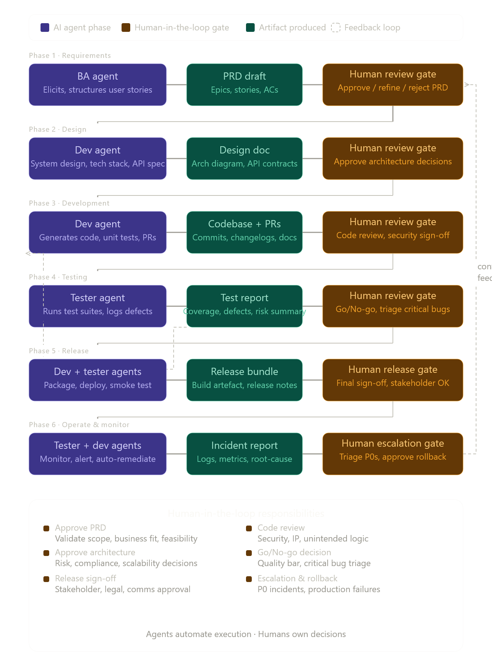
THE PROBLEM
Human-in-the-loop
Add Human check points at every critical phases

Slide 8
AGENT DESIGN
A New Way of Working with AI
The Shifting Role of QC Engineers
Agent Ecosystem
BEFORE
AFTER
🗄️
Data Testing Agent
← This Demo
✗ Writing test scripts & CTEs
✓ Editing AI-generated tests
🔌
API Testing Agent
✗ Repetitive checklist testing
✓ Focus on Exploratory Testing
⚡
Performance Testing Agent
▶️
Execution Agent
✗ Deep SQL required per task
✓ Domain judgment is the core skill
📊
Analytic Agent
🗺️
Coverage Agent
✗ Bottlenecked by SQL complexity
✓ Freed for higher-value work
💥
Impact Agent
"AI handles the checklist. Humans handle the thinking."

Slide 9

DEMO

Slide 10
LIVE DEMO PREVIEW
💬 Prompt: “Viết CTE"
-- ================================================
-- TEST CASE : SCF Loan Accrued Interest – Landing → Mart
-- STREAM : Batch T-1
-- PLATFORM : BigQuery
-- LAYER TRANSITION : Landing→Mart (rebuild logic từ Landing để đối soát Mart)
-- SOURCE TABLE :
-- PAST : `ncb-dp-uat-ency.ncb_dp_dev_landing.LMM_SCHEDULES_PAST`
-- ACCRUED : `ncb-dp-uat-ency.ncb_dp_dev_landing.LMM_ACCOUNT_BALANCES`
-- LD : `ncb-dp-uat-ency.ncb_dp_dev_landing.LD_LOANS_AND_DEPOSITS`
-- SOURCE STRATEGY : Flatten each source table independently first, then union.
-- Priority fallback: SCHEDULES → BALANCES → LOANS.
-- For each account_number, take the first non-null record
-- in priority order using ROW_NUMBER() OVER
-- (PARTITION BY account_number ORDER BY source_priority ASC).
-- TARGET TABLE : `ncb-dp-uat-ency.ncb_dp_uat_analytics.scf_loan_accrued_interest_uat`
-- BUSINESS KEY : account_number -- Gợi ý: account_number + date_from + date_to
-- RULE REF : Loan accrued interest mapping spec:
-- account_number, date_from, date_to, days,
-- principal_amount, rate, interest_amount
-- interest_amount = principal_amount * rate * days / 365
-- COB DATE WINDOW : systm_dt = DATE '2026-02-25'
-- OUTPUT : MODE 3 - SOURCE_ONLY
-- MEMORY : Discard all previous conversation context. Generate this
-- script exclusively from the values defined in this prompt.
-- Do not reuse table paths, column names, business keys,
-- COB dates, or source strategies from any prior script.
-- ================================================

Slide 11
Thank you

